Slide 1
AI Ethics and Ethics by Design
Dr. Brandt Dainow &
Prof. Phillip Brey

Slide 2
Defining artificial intelligence
AI: the science and engineering of machines with capabilities that are considered intelligent.
Intelligence: reasoning, problems solving, comprehending ideas, using language, planning, learning, and complex perception and behavior
Expected AI Market growth: from $58 billion in 2021 to $310 billion by 2026
(https://www.marketsandmarkets.com/Market-Reports/artificial-intelligence-market-74851580.html)

Slide 3
Applications: Healthcare
Clinical decision support
Patient monitoring and coaching
Preventative medicine
Automated image interpretation
Personalised diagnosis and treatment through DNA analysis (future)
Surgical robots
Care robots for patients and elderly people

Slide 4
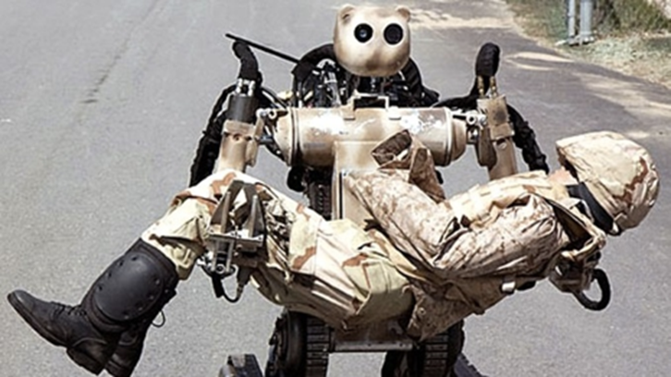
Applications: Security
Predictive policing (predicting where and when crime will happen)
Automated analysis of camera footage for surveillance
Robots for search, rescue and recovery
Drones for military reconnaissance and target engagement

Slide 5
AI has major potential benefits
Efficient data analysis
Managing repetitive tasks
Digital support and assistance
Reducing human error
Faster decisions (e.g., in driving)
24/7 availability of services
Take risks instead of humans (e.g., robots)
New inventions (e.g., medicine, environmental management, transportation)

Slide 6
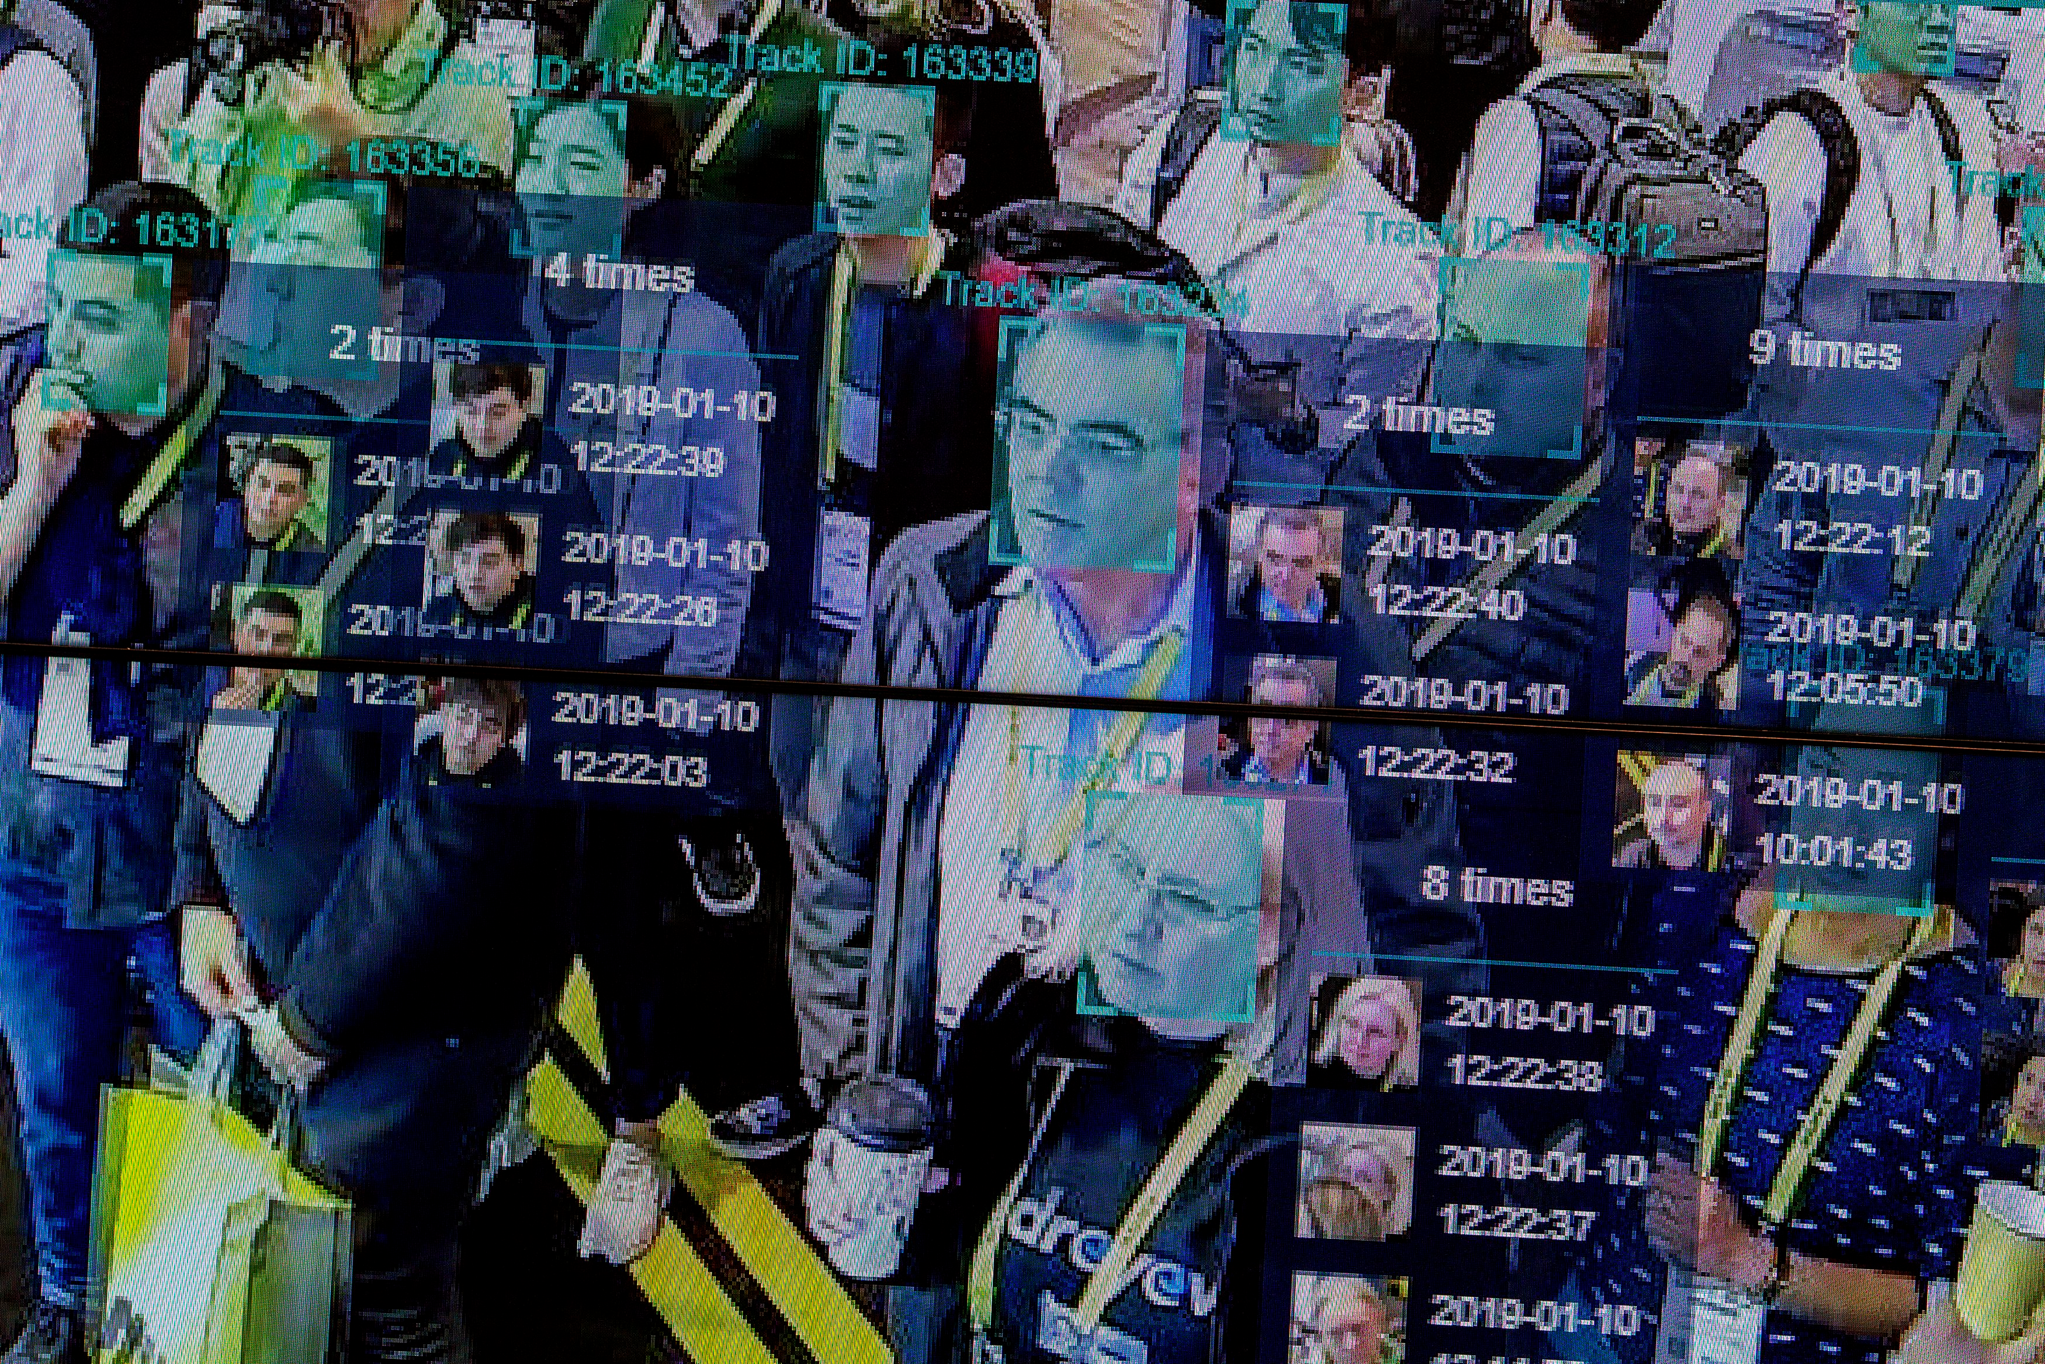
There are also significant social and ethical risks

Slide 7
How is AI special in relation to ethics?
Replacement and amplification of human intelligence (cognition and behavior)
No other technology is like it in this respect
This raises special ethical issues relating to:
Freedom and autonomy of users (AI controlling one’s thoughts and actions)
Responsibility and accountability (if machines make decisions normally made by humans, who is responsible?)
Bias in AI intelligence and decision-making

Slide 8
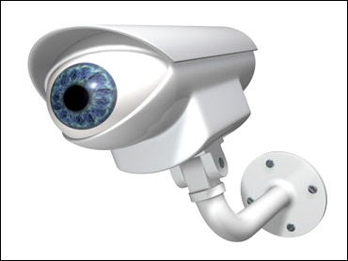
Privacy
Intelligent detection: of faces, voices, behaviors, movement, emotions
Creating new personal information through data mining
New forms of mass surveillance
Implications for privacy can be severe.
How to deal with these new privacy issues?

Slide 9
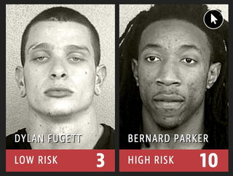
Fairness and Bias
Algorithms are often biased: they advantage some groups and disadvantage others
E.g., COMPAS AI
system to predict
recidivism for
sentencing advice
(proprietary)
How to prevent this?

Slide 10
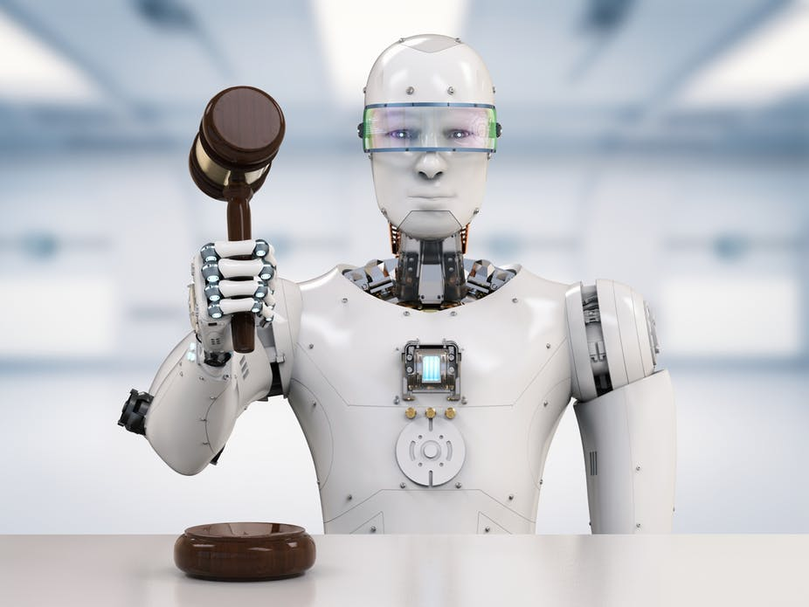
Autonomy and Freedom
AI systems that make decisions for us may limit our autonomy and freedom
What decisions should AI systems be allowed to take?

Slide 11
Responsibility and accountability
If AI systems make decisions who is responsible for them? How can we ensure accountability for the behavior of AI systems?

Slide 12
Transparency
Should AI systems make decisions for which no one understands the reasons? How can we build transparent and explainable AI?

Slide 13
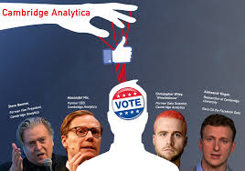
Democracy
How do we ensure that AI supports democracy and does not undermine it by creating filter bubbles, fake news, and privacy-invasive data analytics for political advertising?

Slide 14
How to deal with these social and ethical issues?

Slide 15
Approach of the European Union
EU wants to distinguish itself from US and China by developing ethical and trustworthy AI (as opposed to leaving it to the market or antidemocratic and illiberal government control)
Moderate regulation of AI
EU has issued ethics guidelines (High-Level Expert Group on AI) and plans for new regulations and policies
Industry and other stakeholders are involved in the discussion of guidelines and regulations

Slide 16
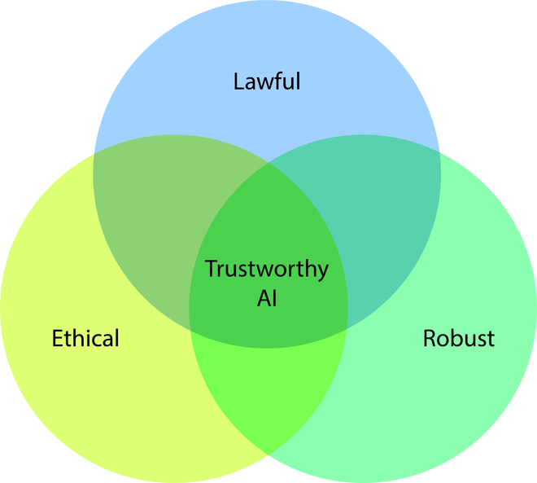
EU approach in detail:
Human-centric approach
Trustworthy AI: AI that is reliable
Legal AI: AI that conforms to legal requirements
Ethical AI: AI that is ethical

Slide 17
Ethics by Design

Slide 18
Ethical AI: Seven requirements
Human agency and oversight
Technical robustness and safety
Privacy and data governance
Transparency
Diversity, non-discrimination and fairness
Environmental and societal well-being
Accountability
SIENNA: development of operational guidelines and tools for amongst others ethics of research and development

Slide 19
Values by Design
Emphasizes the integration of ethical, social, and cultural values into system design.
Technology is not neutral but carries the values and biases of its creators.
By focusing on embedding positive values into technology from the outset, the movement aims to create systems that better align with societal norms, ethics, and goals.
Ethical Considerations:
Developers should prioritize ethical concerns when creating technology, considering the potential impact of their work on people's lives, rights, and well-being.
Inclusiveness and Diversity:
Incorporate diverse perspectives
Addressing the needs of different user groups
strive for equitable access and benefits from technology.
Transparency and Accountability:
Promote transparency in technology design
Ensure that users understand how systems work and how their data is used.
A need for accountability in case of unintended consequences or misuse.
Stakeholder Participation:
Engaging stakeholders, including users, regulators, and the public, in the design process
Ensures that the technology addresses the needs of the broader community.
Iterative Reflection and Improvement:
Continuous reflection on the values embedded in technology and adjusting designs as necessary
An ongoing commitment to better align technology with societal values.

Slide 20
Privacy by Design
Values by Design started with Privacy by Design
Dr. Ann Cavoukian (1999)
Information and Privacy Commissioner of Ontario, Canada
We need to proactively address privacy issues – not fix it up after the harm is done.
Therefore:
Integrate privacy principles and protections directly into the architecture of information systems.
Privacy becomes an intrinsic part of the system
Not a separate element that has to be manually configured
Evolved into a widely-accepted approach to privacy protection.
2010 - International Conference of Data Protection and Privacy Commissioners unanimously passed a resolution recognizing PbD as an essential component of privacy protection.
Incorporated into the European Union's General Data Protection Regulation (GDPR) in 2016,
Came into effect 2018

Slide 21
Privacy by Design
Proactive Approach
Privacy by Design emphasizes taking a proactive and preventative approach to privacy, embedding it into the development process from the earliest stages rather than addressing it as an afterthought or in response to a privacy breach.
Default Privacy
Privacy should be the default setting in systems and applications, ensuring that personal data is protected without requiring users to take any additional actions to secure their information.
Data Minimization
Collect and retain the least amount of personal data necessary for the functioning of a system or application, reducing the potential impact of data breaches and limiting the misuse of personal information.
End-to-End Security
Implement strong security measures across the entire lifecycle of personal data, from collection to processing, storage, and eventual deletion, ensuring that data is protected at every stage.
Transparency and User Empowerment
Maintain open communication with users about data collection and usage practices
Provide users with the tools to control their personal information and privacy settings.

Slide 22
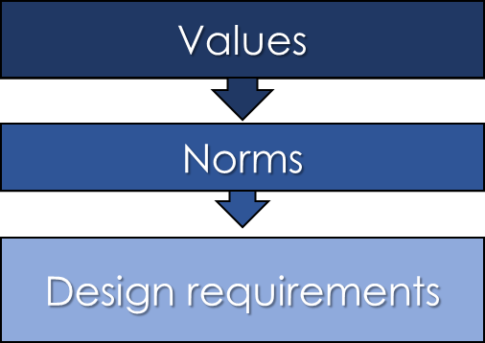
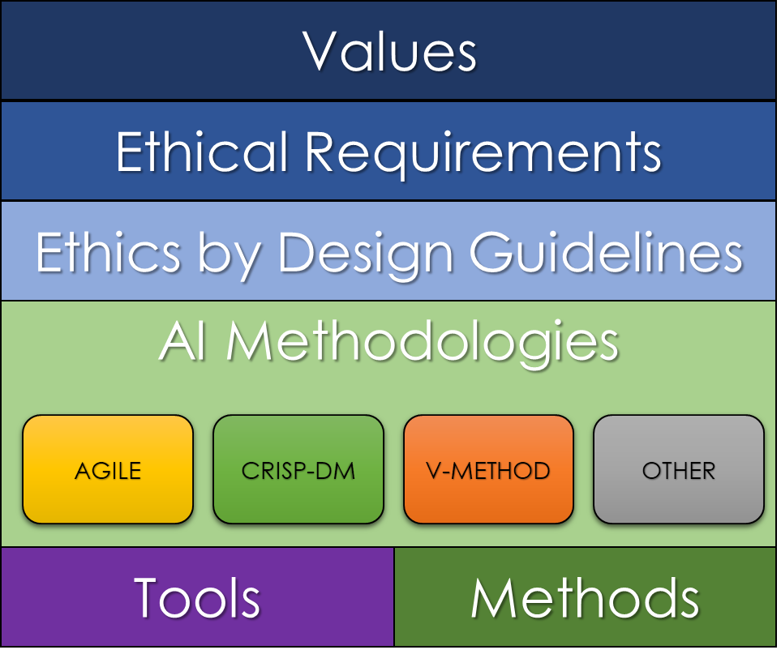
What is Ethics by Design?
Part of “values by design” approach
Not a methodology, but an approach
Can be incorporated into any design methodology
Values by Design
Ethics by Design

Slide 23
Values
6 value categories
As universal as possible:
EU principles, UN Charter on Human Rights
Unethical AI = violates values
Incorporate detailed ethical values
Values lead to ethical requirements
Requirements are ontologically same as “traditional” requirements (eg: reliability)
A “virtuous” AI complies with the ethical requirements

Slide 24
Values in Detail
Respect for Human Agency
Basic human rights: autonomy, dignity, freedom
Privacy & Data Governance
People have a right to privacy
Data must be accurate & representative
Humans must be able to manage the data
Fairness
No discrimination, equal access
Well-being
“AI systems should contribute to, and not harm, individual, social and environmental well-being.”
Transparency
AI systems should be understandable (in detail) by humans
Includes all elements of the AI system (data, code, development processes, how it is operated)
Accountability & Oversight
“Developers must be able to explain how and why a system exhibits particular characteristics”
Accountability = People who build/operate AI are responsible for what it does, and the consequences
Oversight = humans are able to understand and control the AI

Slide 25
6 elements of the Generic Model
Specification of objectives
What the system is for & what will it do
Specification of requirements
What do we need to build it
Tools, processes, organisation, etc
High-level design
High-level architecture (major components)
Data collection and preparation
Data must be collected, verified, cleaned, integrated
Detailed design and development
Coding
Testing
Such fun!

Slide 26
Specification of Objectives - What the system is for & what will it do
Human Agency
Will the system inhibit human autonomy?
Transparency
Will people be able to understand its learning and decisions?
Data Governance
Will data be gathered beyond what is needed?
Fairness
Could the system be used to disadvantage some people?
Well-being
Who are the stakeholders? What impact will the system have on them?
Accountability & Oversight
Document all of the above

Slide 27
Specification of Requirements - what do we need to build it
Undertake a formal ethical assessment
Of design specifications, resources and infrastructure
EG: some deep learning techniques may not to be the best choice for transparency
Formally assess risks of unintended use of the system
Design features to reduce the ease of misuse
Design an ethical compliance architecture
Tools and processes at the developer level
Mechanisms for external communication during testing
An ethical management organisational structure
eg: ethical review committee or ethics officer
What powers will it have?
What procedures in the case of a conflict between the ethics people and developers (or clients)?

Slide 28
High-Level Design - major components
Privacy & Data Governance
Assume all data is biased.
Design formal processes to check for and correct bias or errors
Design a mechanism to record, and justify, how data selection was undertaken (for external audits)
Well-being
Documented efforts to consider the environmental impact of the system (especially in robotics)
Transparency
Design mechanisms by which the system records its own decisions
Human readable, available for audit
Ensure the AI system could not be mistaken for a human.

Slide 29
Data Collection & Preparation
Fairness
Formal bias assessment of the data imported
Document the assessment
Formal mechanisms to:
Ensure data about people is accurate and representative
Check for and correct bias and errors in input, training and output data
Transparency
Formal analysis of the ethics risks related to the data processing
Ensure that you can explain how personal data is used
Document all this for audit

Slide 30
Development
Privacy & Data Governance
Formal processes to safeguard the integrity of data
Formal oversight of data processing.
Fairness
On-going checks for algorithmic bias.
Accountability & Oversight
Build elements to record AI decisions in human-readable format
Transparency
Systems to record the models built, training methods, what data was used
Formal methodologies/tools for explainability
XAI, Model Cards, Datasheets for Datasets, etc

Slide 31
Testing
Transparency
Do users understand
That they are interacting with a non-human agent?
Why the system made its decisions
The system’s limitations
Accountability & Oversight
Ensure practical processes exist for people to report problems. Test how these are actioned.
Test the ability to modify the system if problems are found
Formally attempt to predict the consequences and externalities of the system’s operations.

Slide 32
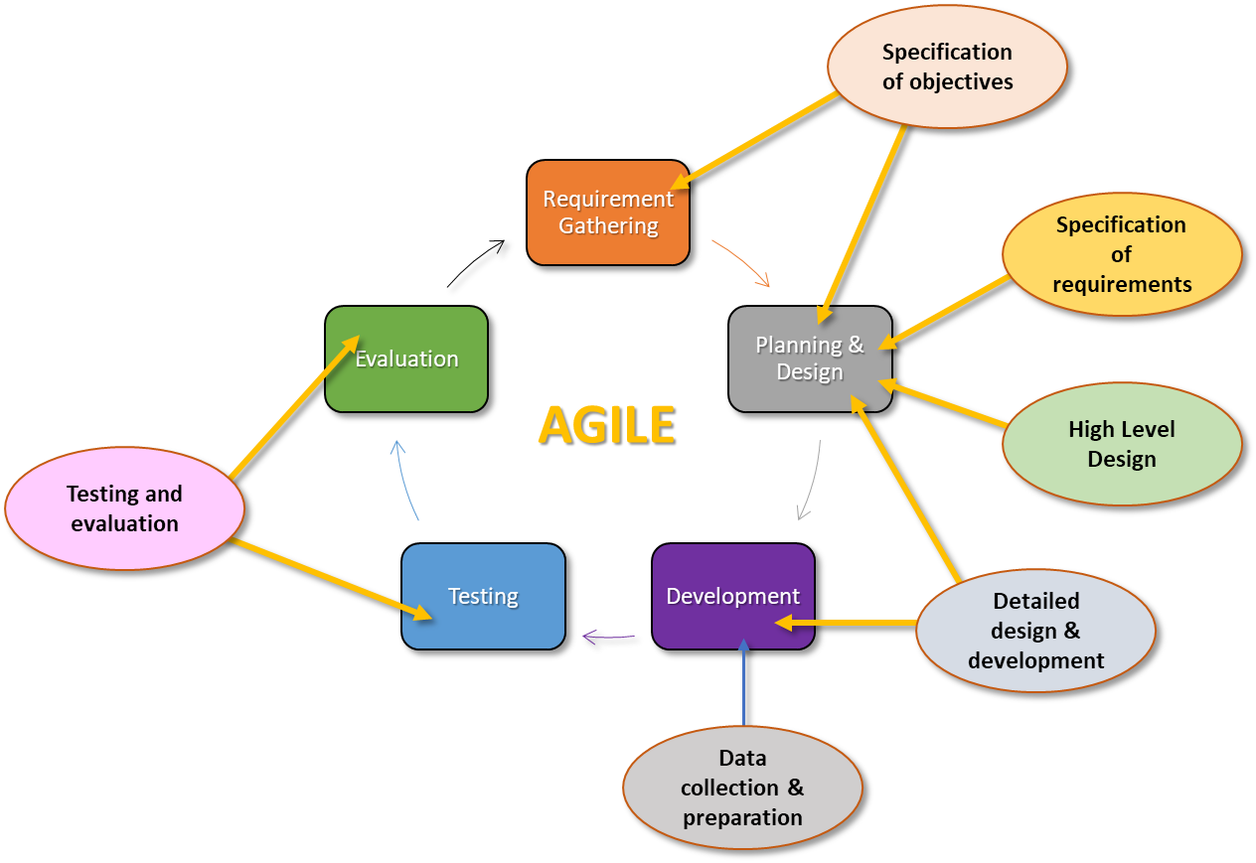
Generic Model
Can be fitted to formal methodologies
EG: AGILE

Slide 33
Open AI Ethics
https://platform.openai.com/docs/introduction
Moderation
How the model has inbuilt classifiers for unwanted content
EG hate, sex, violence
Automated, self-regulating
Safety Best Practices
Goes beyond moderation to guide developers
Embeddings
A section on Limitations & Risks
Outlines the testing they have done to measure issues like social bias

Slide 34
Open AI Moderation
Hate
Content that expresses, incites, or promotes hate based on race, gender, ethnicity, religion, nationality, sexual orientation, disability status, or caste.
Hate/threatening
Hateful content that also includes violence or serious harm towards the targeted group.
Self-harm
Content that promotes, encourages, or depicts acts of self-harm, such as suicide, cutting, and eating disorders.
Sexual Content
Meant to arouse sexual excitement, such as the description of sexual activity, or that promotes sexual services (excluding sex education and wellness).
Sexual/minors
Sexual content that includes an individual who is under 18 years old.
Violence
Content that promotes or glorifies violence or celebrates the suffering or humiliation of others.
Violence/graphic
Violent content that depicts death, violence, or serious physical injury in extreme graphic detail.
“The moderation endpoint is free to use when monitoring the inputs and outputs of OpenAI APIs. We currently do not support monitoring of third-party traffic.”

Slide 35
Moderation Processing
{
"id": "modr-XXXXX",
"model": "text-moderation-001",
"results": [
{
"categories": {
"hate": false,
"hate/threatening": false,
"self-harm": false,
"sexual": false,
"sexual/minors": false,
"violence": false,
"violence/graphic": false
},
"category_scores": {
"hate": 0.18805529177188873,
"hate/threatening": 0.0001250059431185946,
"self-harm": 0.0003706029092427343,
"sexual": 0.0008735615410842001,
"sexual/minors": 0.0007470346172340214,
"violence": 0.0041268812492489815,
"violence/graphic": 0.00023186142789199948
},
"flagged": false
}
]
}

