Slide 1
CS439 – Lecture Feb 29, 2024

Slide 2
Surveillance

Slide 3
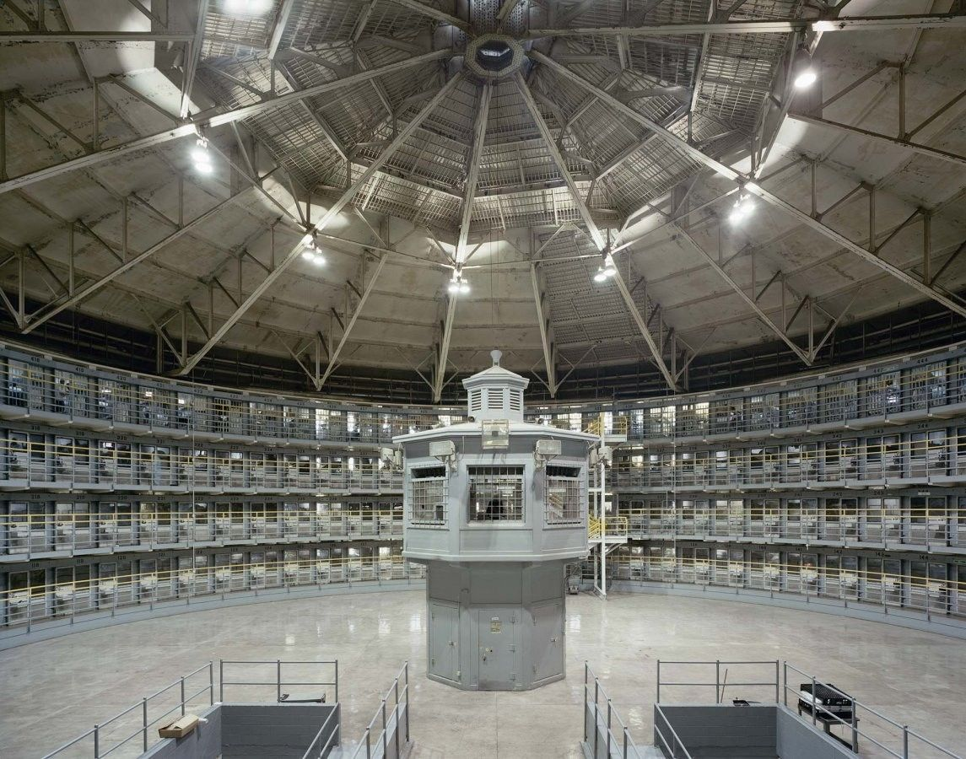
The Panopticon
Jeremy Bentham, 1785
Monitor the most prisoners with the fewest guards
central tower for the guards, surrounded by a ring-shaped building of prison cells
Inmates don’t know if they are being watched at any moment
So act as if being observed all the time
“chilling effect”
Symbol of
A social control mechanism
Modern authoritarian control
Digital surveillance

Slide 4
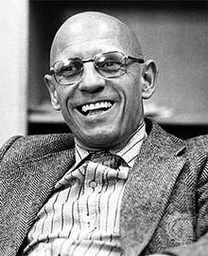
Focault
Discipline & Punish (1975)
The prisoner “is seen, but he does not see; he is the object of information, never a subject in communication.”
“Bentham laid down the principle that power should be visible and unverifiable. Visible: the inmate will constantly have before his eyes the tall outline of the central tower from which he is spied upon. Unverifiable: the inmate must never know whether he is being looked at at any one moment; but he must be sure that he may always be so.”
“He who is subjected to a field of visibility, and who knows it, assumes responsibility for the constraints of power; he makes them play spontaneously upon himself; he inscribes in himself the power relation in which he simultaneously plays both roles; he becomes the principle of his own subjection.”

Slide 5
Personal Profile
Electronic record of you
As much data from as many sources as possible
At least 5 billion people
Digital persona
Individual’s online expression of self
Created through online communicative acts
blogs, reviews, forums, chatrooms, email, profile pages, websites, videos, podcasts, etc.
Data shadow
Record of an individual’s activity + analysis thereof
Data created unintentionally
Logs
Data created through surveillance
Doing other things via tracking technology
Digital + Offline

Slide 6
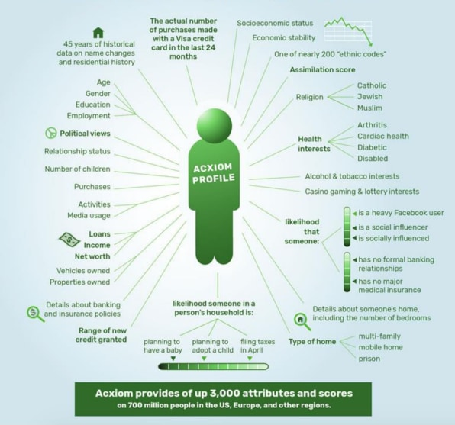
acxiom.com

Slide 7
“Data is the new oil”
Digital tracking
Online
Cookies, web bugs, LSO
Phones
Apps, cookies
Offline
Facial recognition, Phone, Gait, voice, emotion
Mixed
Connections, movement, conversations, purchases
Average of 70 tracking companies per website

Slide 8
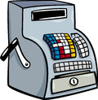
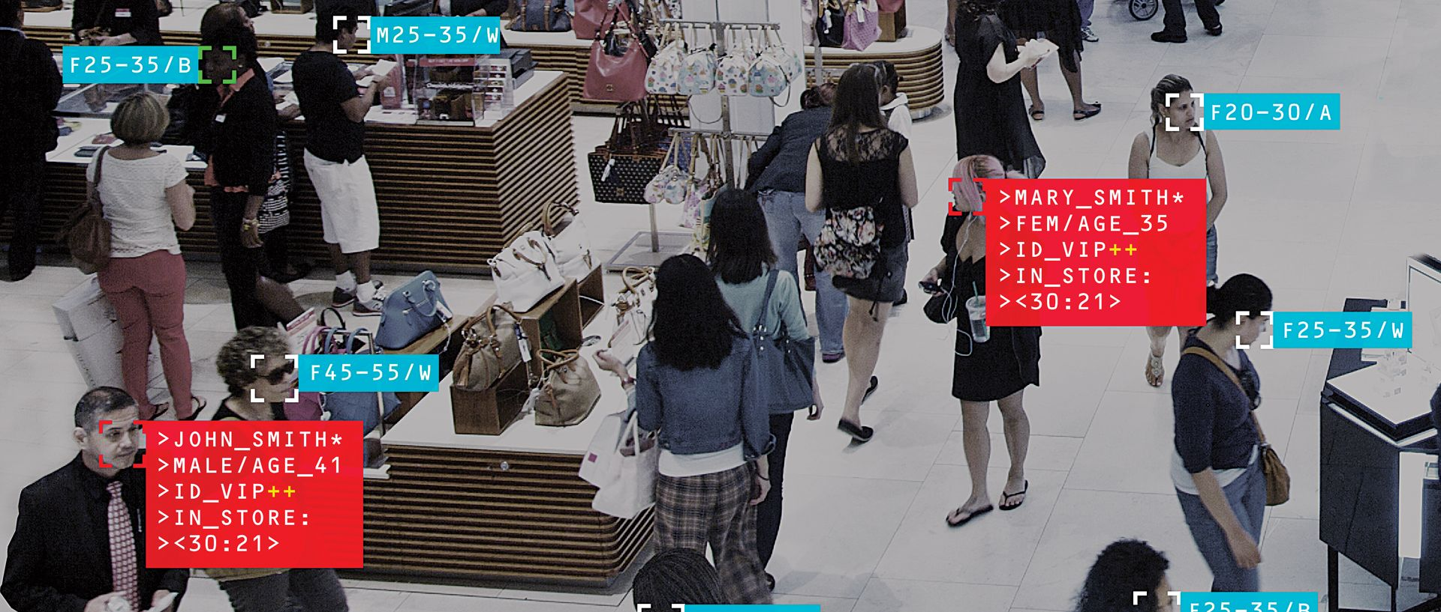
M&S, Topshop
Cellular
Facial Recognition
Wifi
Bluetooth
Gait Analysis
Name
RFID
MAC address

Slide 9
Instore Analytics
“It is necessary to capture the data at each point of interaction, online or offline, in order to provide the shopper with a flowless experience, ultimately boosting sales”
Wi-Fi positioning: Measure Wi-Fi intensity from the visitor’s phone. Detects the phone’s MAC address. Not necessary to connect to the Wi-Fi network.
Video analysis: Detects the movement of visitors. Can recognise demographic profiles (gender/age/race), facial recognition, emotions.
Bluetooth: Comparable to Wi-Fi. Detects the MAC address. Bluetooth need not be enabled.
Beacons: low-energy Bluetooth positioning technology inside apps.
Ultrasonic positioning: Store’s microphones detect ultrasonic waves emitted by the store’s app in the phone. Waveform can be unique to each person.
NFC: The short range of the NFC is particularly well suited to micro-location & uses passive tags to detect a nearby device via RFID in products and shelves.
GPS Not effective indoors. App communicates the GPS coordinates of the customer (approx. 33 ft accuracy).

Slide 10
Educational Surveillance
Hiksoft Intelligent Classroom Behavior Management System
Records students' facial expressions
Sorts into happy, angry, fearful, confused, bored, upset.
Records student actions
EG: writing, reading, raising a hand, sleeping
“Beforehand in some classes that I didn’t like much, sometimes I would be lazy and do things like take naps on the desk or flick through other textbooks. Since the school has introduced these cameras, it is like there are a pair of mystery eyes constantly watching me, and I don’t dare let my mind wander.”

Slide 11
Windows 10+
How Microsoft handles diagnostic data
The diagnostic data is categorized into four levels:
Security. Information that’s required to help keep Windows and Windows Server secure, including data about the Connected User Experiences and Telemetry component settings, the Malicious Software Removal Tool, and Windows Defender.
Basic. Basic device info, including: quality-related data, app compatibility, and data from the Security level.
Enhanced. Additional insights, including: how Windows, Windows Server, and apps are used, how they perform, advanced reliability data, and data from both the Basic and the Security levels.
Full. Includes information about the websites you browse, how you use apps and features, plus additional information about device health, device activity (sometimes referred to as usage), and enhanced error reporting. At Full, Microsoft also collects the memory state of your device when a system or app crash occurs. It includes data from the Security, Basic, and Enhanced levels.
Diagnostic data levels are cumulative, meaning each subsequent level includes data collected through lower levels.

Slide 12
Secrecy
Nest microphone
“The on-device microphone was never intended to be a secret and should have been listed in the tech specs. That was an error on our part. The microphone has never been turned on. The mic was built into the device so we could offer additional features to our users in the future, such as the ability to detect broken glass.”
Facebook Pixel
“When someone visits your website, the Facebook pixel is triggered and reports this action”
“If you’re logged out or don’t have a Facebook account and visit a website with the Like button, your browser sends us info”
Samsung TV
“Don’t have private conversations in front of your TV.”

Slide 13
Data Brokers
80% of internet economy
Annual growth 5,000%
LiveRamp Identity Resolution
“Our identity system links anonymous device IDs, cookie IDs, and other online IDs from publishers, platforms, or data providers around an IdentityLink—a single person-based identifier. This allows marketers to perform the personalized targeting and measurement of the user in anonymous spaces.”
How many data brokers? Who are they?
Mercedez
“Google & Facebook gather megabytes of data every day on their users, but we only get a few kilobytes, so we may offer free cars in exchange for more data”

Slide 14
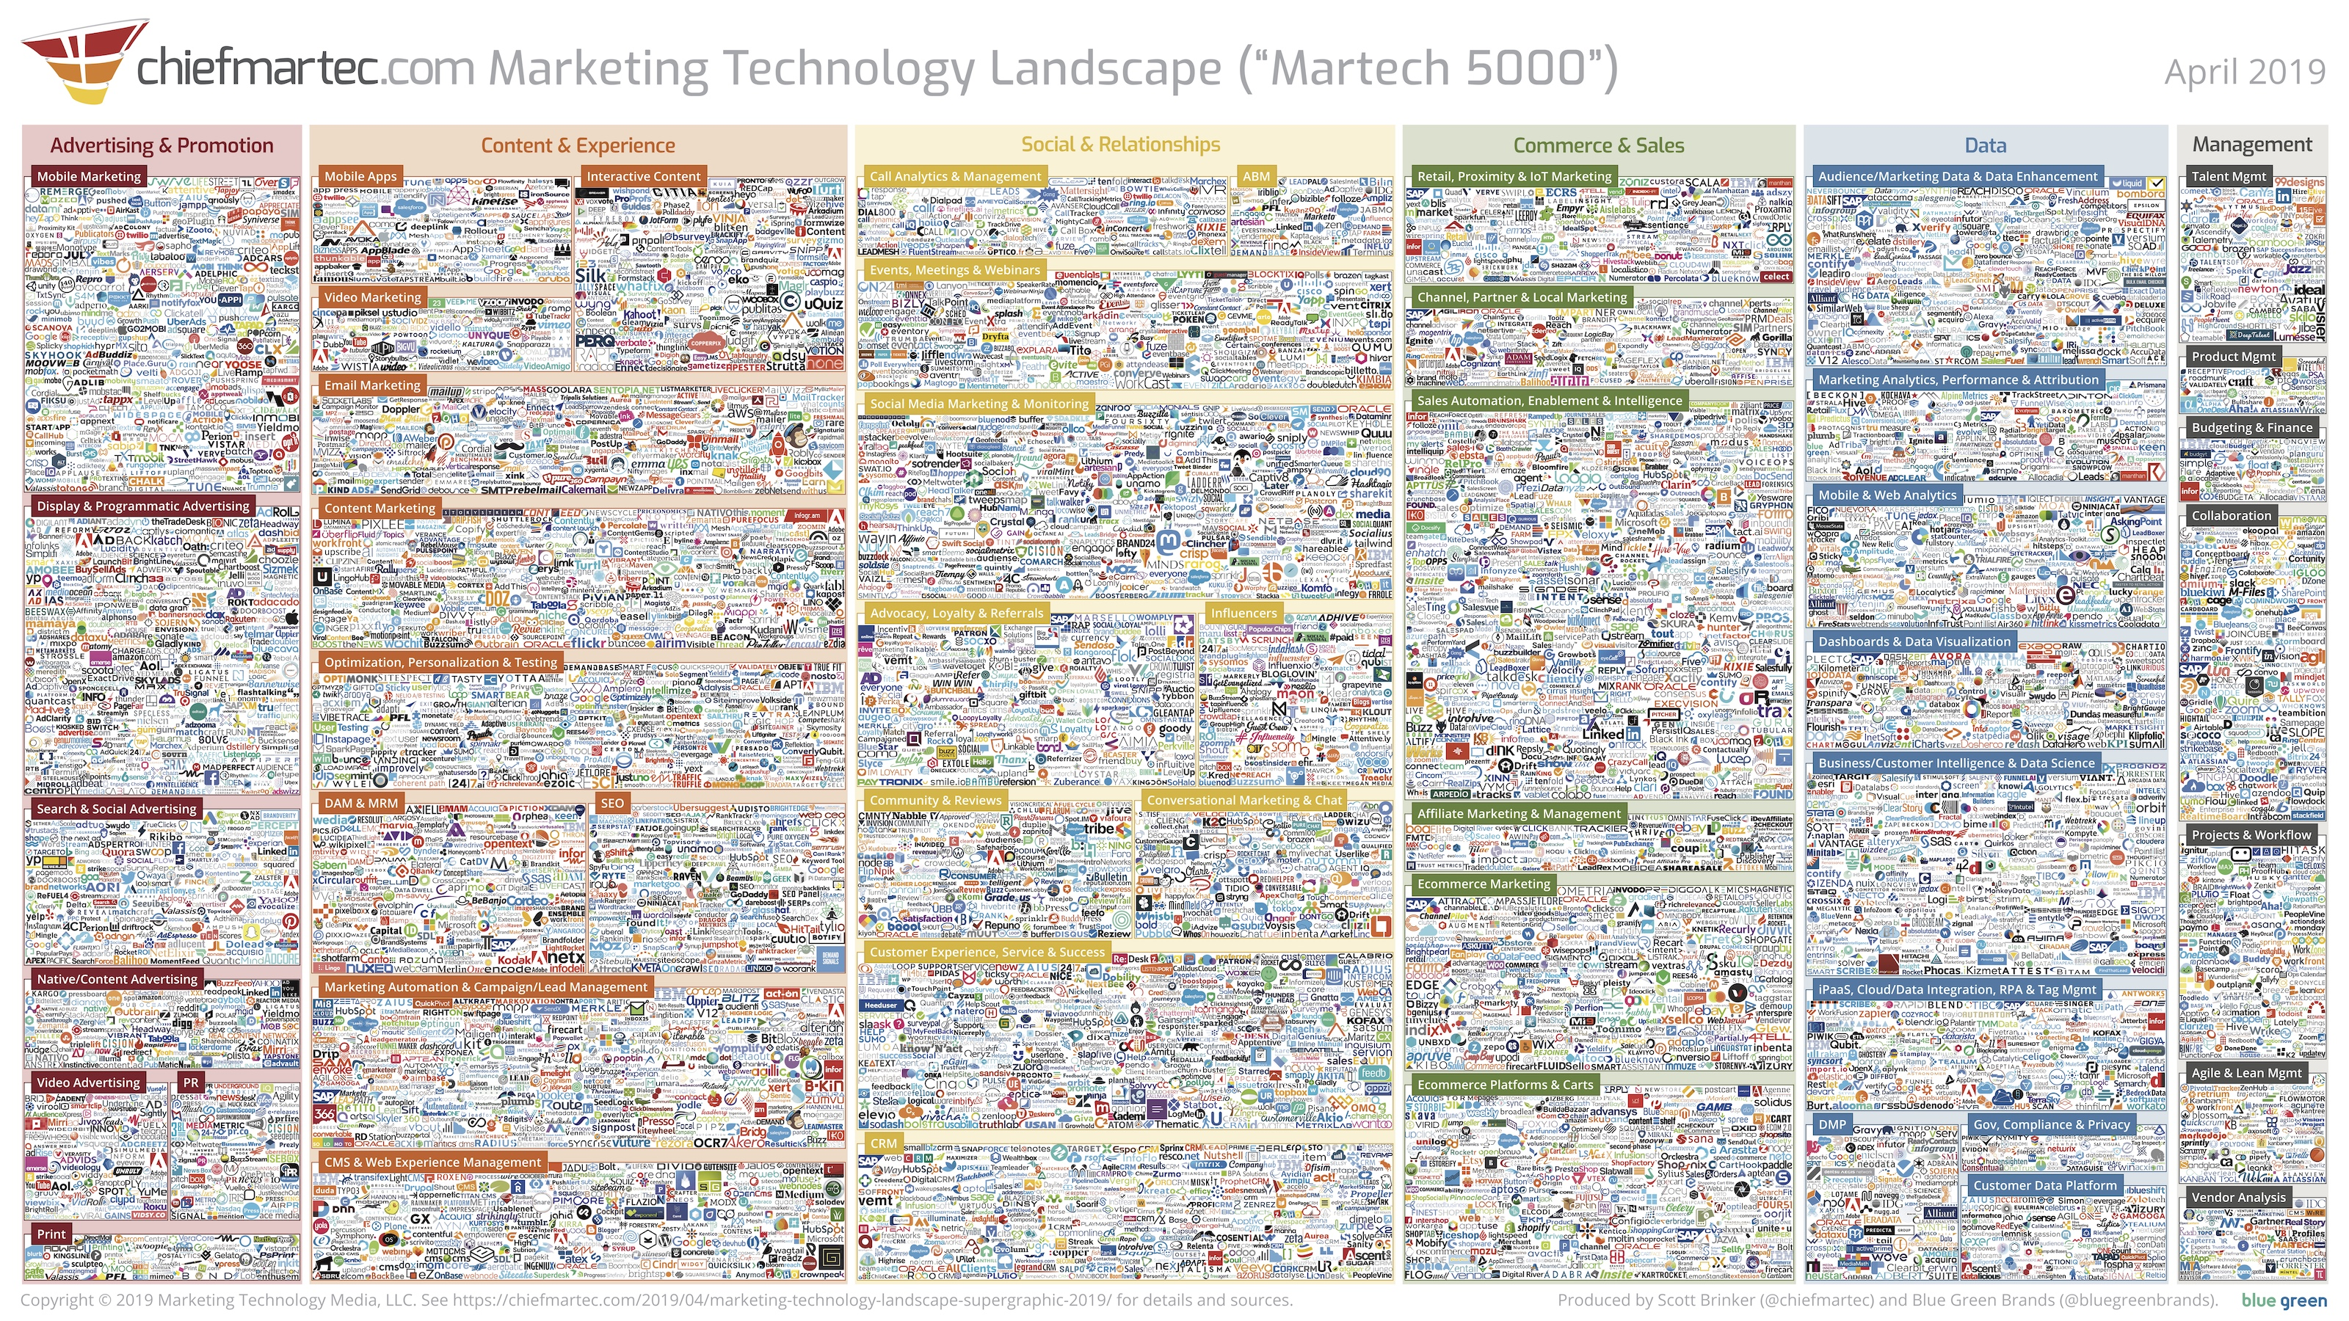

Slide 15
Chinese Social Credit System

Slide 16
China Social Credit System
Nationwide scheme for tracking the trustworthiness of citizens, corporations and government officials
“Chinese Social Trust System”
Four areas – administrative affairs, commercial activities, social behavior, law enforcement
Chinese Governmant:
Designed to boost public confidence and fight corruption and fraud.
Western critics:
Intrusive surveillance apparatus for punishing dissidents and infringing privacy.

Slide 17
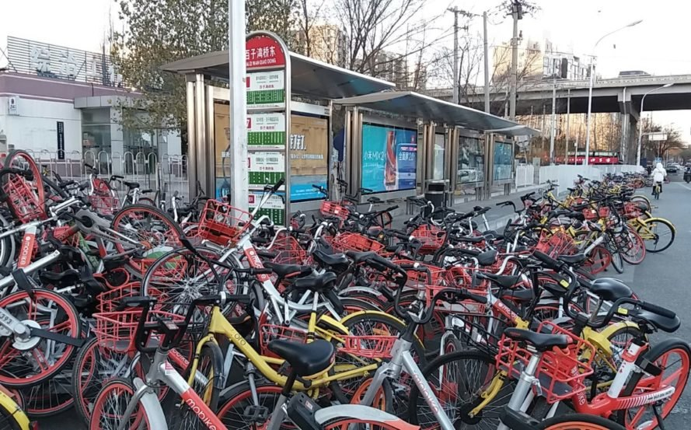
Public trust in China

Slide 18
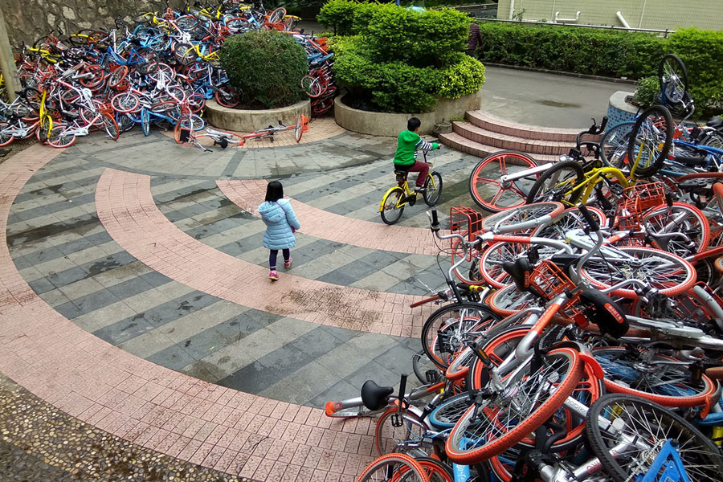

Slide 19
How it Works
Central public government database
People
Companies
Government Departments
“Legal Representative” = responsible for company’s actions
Others can add to & use government database
And create their own databases
Companies, local authorities, government departments
“Promoted by government and built together with society”
Government – regulation, standards, social participation & support
Market – build & popularise
Concept of privacy does not apply to government

Slide 20
Punishments
Public shaming
Restrictions on travel
Slow internet
Children cannot attend top schools
Banned from joining many clubs
Cannot work for government or banks
Cannot get loans
Banned from good hotels
Cannot holiday in some areas
Pets confiscated

Slide 22
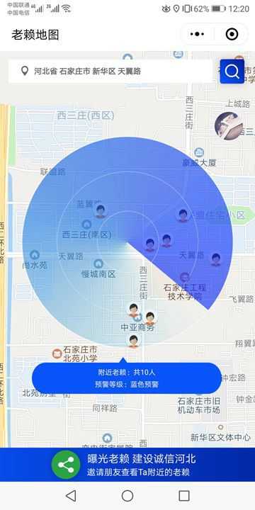
Hebei’s Deadbeat Debtors App
Identify debtors within 500 meters
So you can “follow them and encourage them to pay up”

Slide 23
Social Scoring
Still in development
Everyone has public scores (“reputation systems”)
Varies based on activities
Deduct points – too much time on video games, buying too much beer, having the wrong friends, jay walking
Gain points – donate to charity, attend political education classes, take exercise class
Multiple scoring systems
Apps, city authorities, legal etc
Blacklists, whitelists
EG: List of people who have disobeyed court orders
Public praise & blame
Punishments (eg: no access to air travel, cannot join sports clubs)
Auto phone message when calling someone - “Warning, this person is on the blacklist. Be careful and urge them to repay their debts.”
Rewards (eg: no deposit on hotel booking, skip queue in hospital)
Data gathering via AI and human reporting

Slide 24
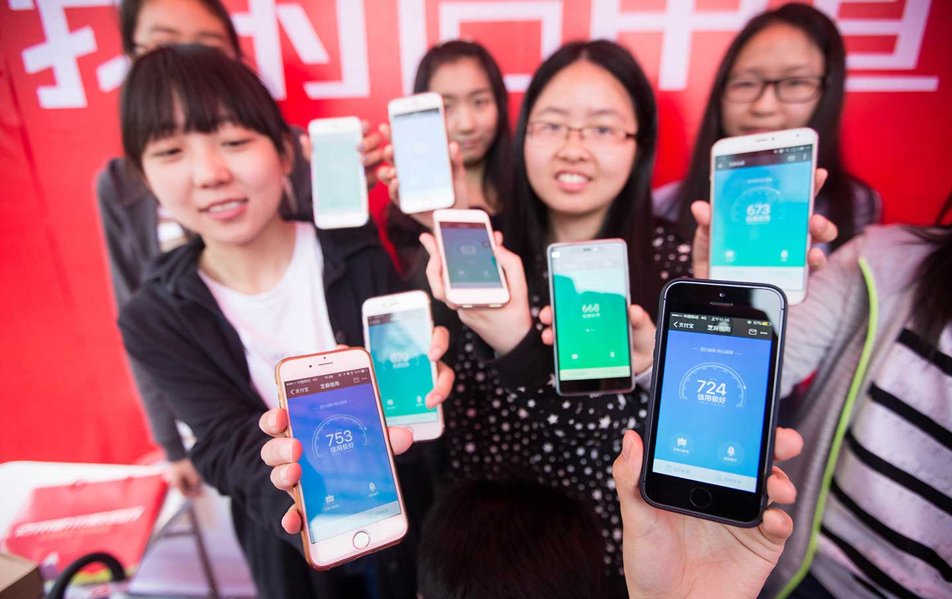

Slide 25
Douyin – deadbeat advertising
Chinese version of TikTok

Slide 26
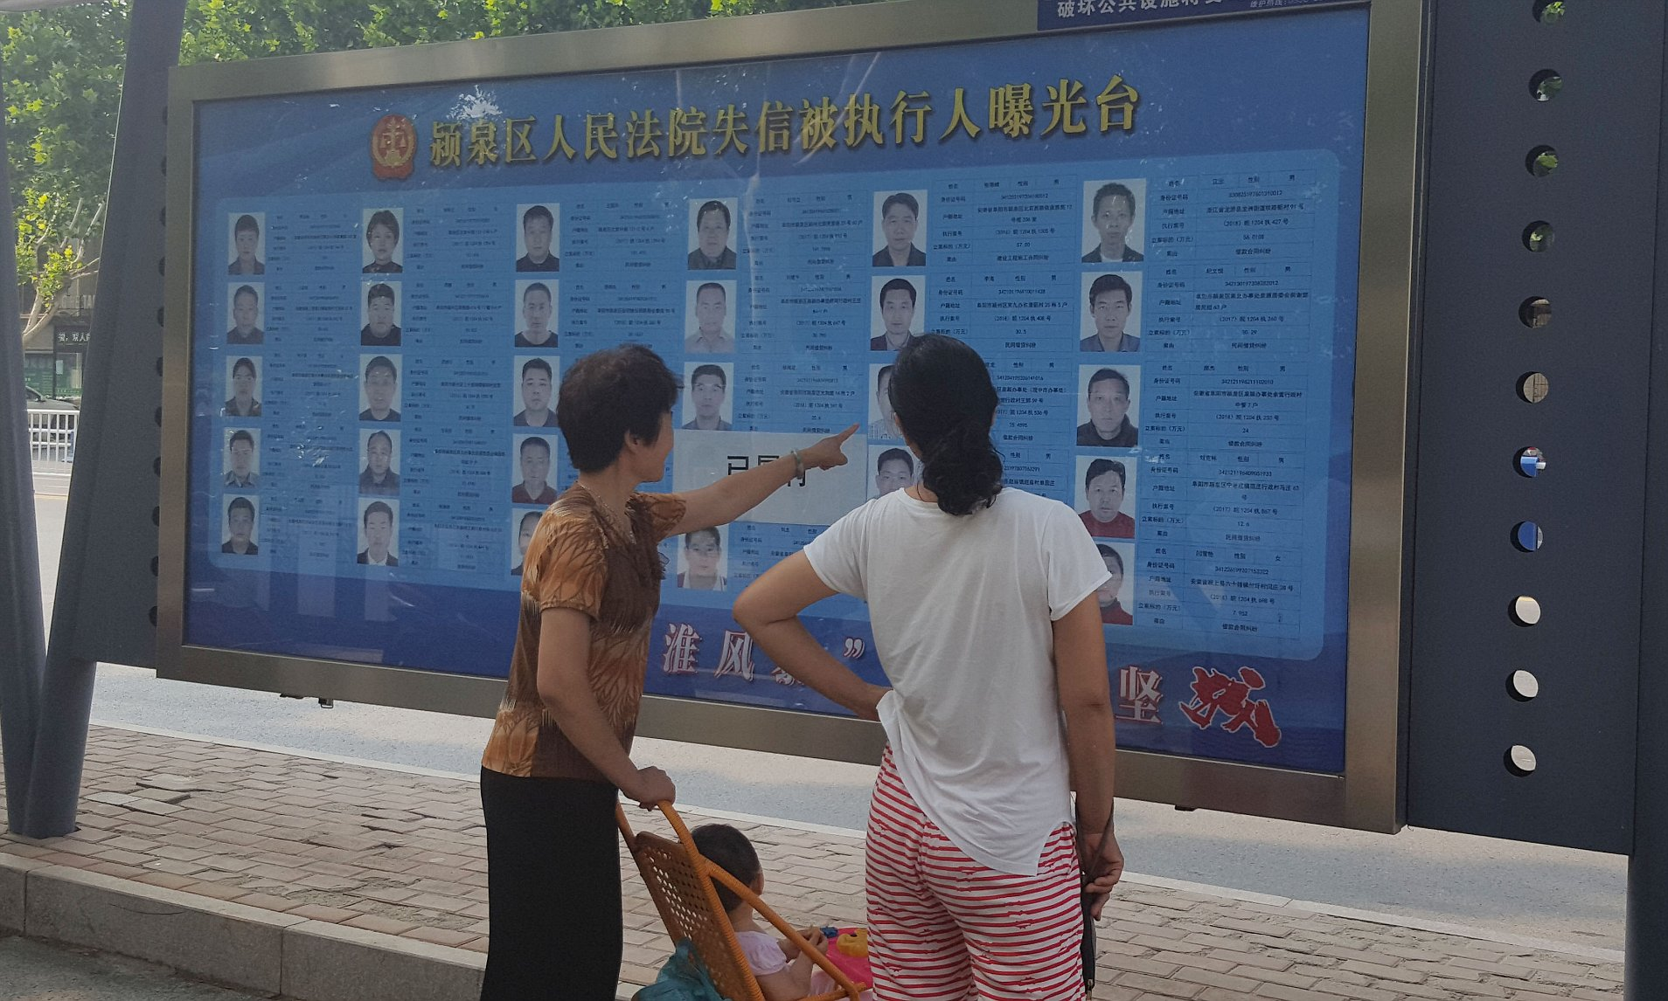
Low Score Information Boards

Slide 27
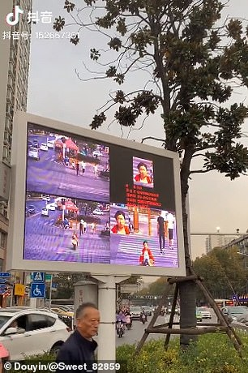
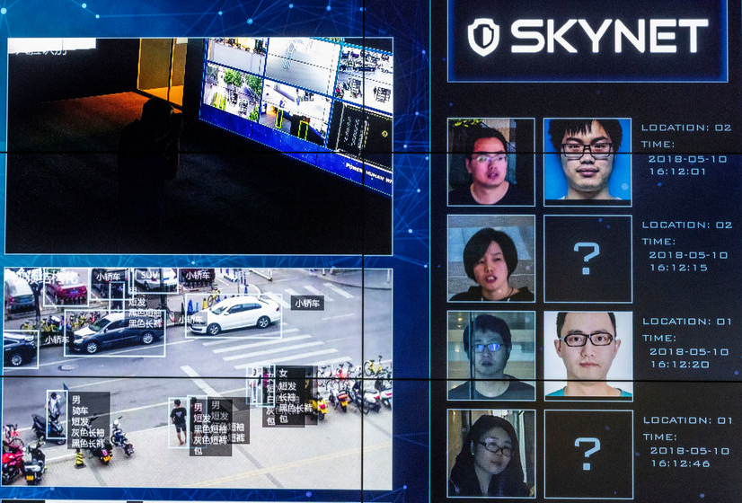
Jaywalking

Slide 28
Deducting Points
Yunnan – late paying electricity bills
Shenzhen – quitting job without sufficient notice
Shanghai – honking the car horn
Jiangsu – not visiting your parents enough
Ningxia – being religious
Beijing – filing a complaint about government errors
Everywhere - being related to a low score person
“Someone who plays video games for 10 hours a day would be considered an idle person, and someone who frequently buys diapers would be considered a responsible parent…We want people to be aware that their online behavior has an influence on their online credit score so they know to behave themselves better.” - Joe Tsai, Alibaba Vice-Chair

Slide 29
Public Attitudes
Privacy in China is between individuals & businesses
Nothing is private from the government
Quality of life is more important than privacy
80% approve
Many think the Western credit score is same thing
Concerns – fairness and transparency
80% use commercial systems (eg: Tencent, Sesame)
7% aware of government systems
77% prefer government over commercial
Primary support – rich & urban
Can afford to pay for higher scores (eg: donations)
Better access to benefits (eg: free bike share)
70% - close “regulatory gaps”
Chinese people cannot be trusted
No legal enforcement in China
Affects behaviour
16% have unfriended someone to enhance their score
20% have modified posts to enhance score

Slide 30
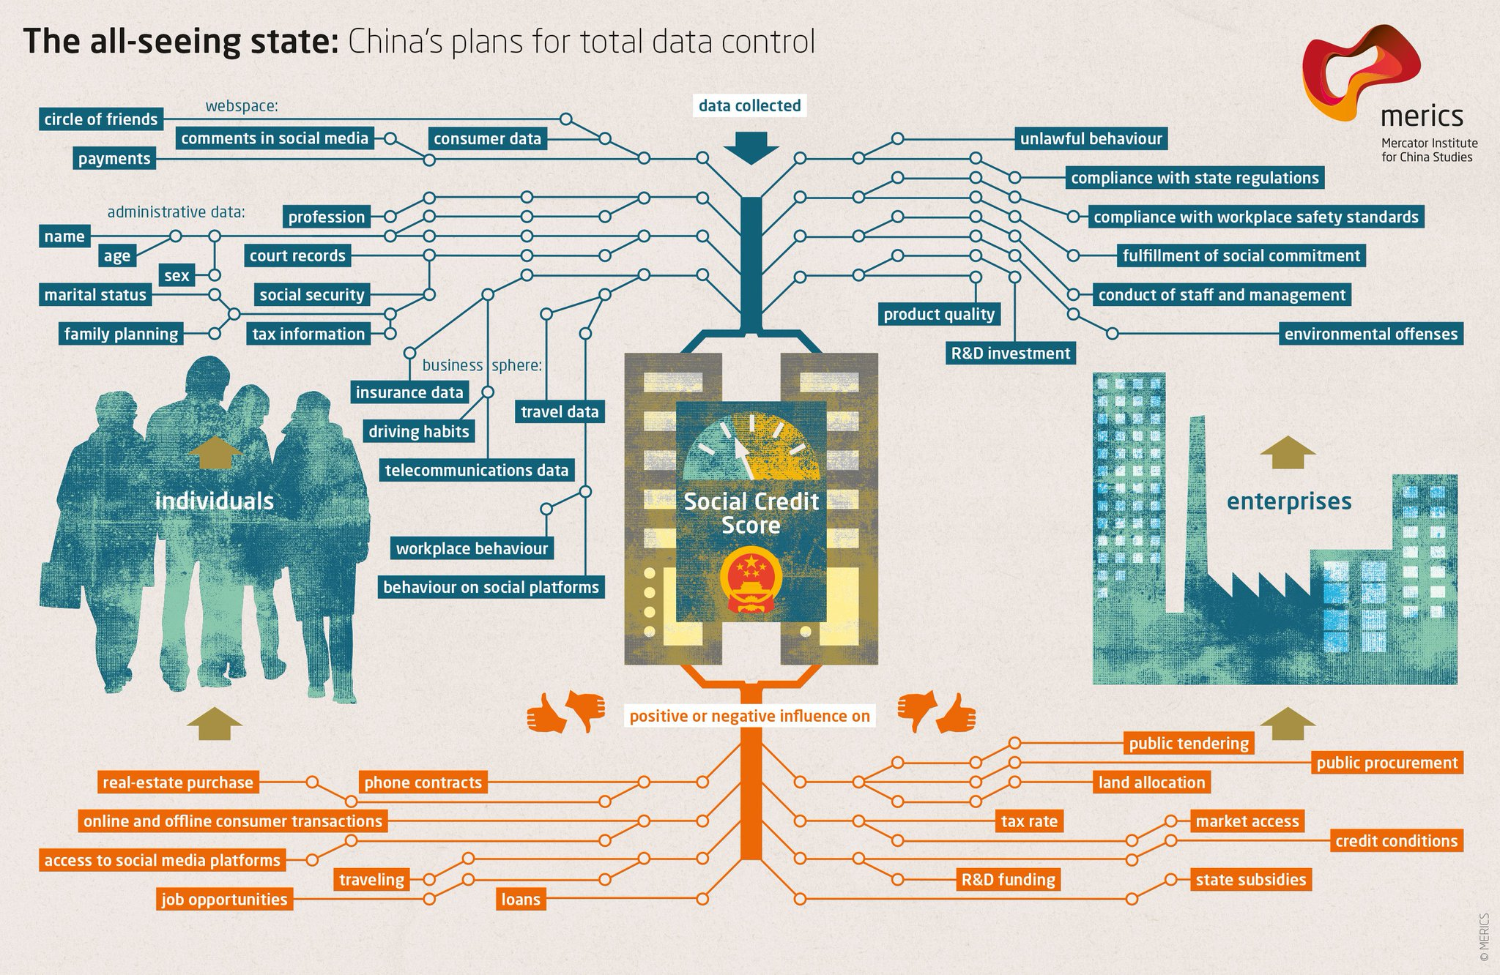
“Credit” = “Trust”

Slide 31
Exports
“Safe City Systems”
“We will give you the technology for free or half-price and process your citizen data for you.”
Kazakhstan, Kyrgyzstan, Mongolia, Laos, Saudi Arabia, Cambodia, Thailand, Myanmar, Turkey, Russia, Iran
Uzbekistan Safe Cities Surveillance Project
$1 billion donation from China
Chinese companies (CITIC & COSTAR), China Information Technology Development Ministry, equipment from Huawei
Compulsory if want Chinese investment
Will cover whole country by 2023

Slide 32
Issues
Autonomy
Vs state
Vs community
Justice
Fair, equitable, transparent
Sociality
Conflict vs. harmony
Democracy vs dictatorship
Who decides

Slide 33
Zuboff
Surveillance Capitalism

Slide 34
Professor Shoshana Zuboff 1951 -
Social psychologist, Harvard Business School
Surveillance capitalism as a "rogue mutation of capitalism”
Main works:
Big Other: Surveillance Capitalism and the Prospects of an Information Civilization (2015)
The Age of Surveillance Capitalism: The Fight for a Human Future at the New Frontier of Power (2019)
The Support Economy (2002)
Digital technology can either:
Decentralise
Giving everyone more control of their own lives
Makes society more eco-friendly
Gives everyone more say in society
Centralise
Individuals become dominated by corporations
Ecologically damaging
Most get poorer as a few rich business owners aggregate wealth

Slide 35
The Age of Surveillance Capitalism - Key Concepts
Prediction
Surveillance Capitalism
Processes
Innovation driver
Data Industry
Instrumentalism
Instrumentalist power
Threats to
Democracy
Autonomy
Notes:
Instrumentalism
She calls this instrumentarian power, in contrast to totalitarian power. Instrumentarian power. Two reasons: One, it relies on the instrumentation of the digital age because it’s through that medium that we are being tuned and herded and shunted and coached and modified. Instrumentarian power wants to control you, but it doesn’t care about hurting you. It wants to control you toward its guaranteed commercial outcomes. You are simply instrumentalized toward the outcomes of its business customers. So you’re a means to others’ commercial ends. You’re instrumentalized and you’re surrounded by this milieu of instrumentation that is sort of hands-off. It’s your dishwasher, and your television set, and your car and the telematics, and your phone. It’s this whole digital surround that is now the instrumented medium that is producing the knowledge that creates the opportunity for the power to modify your behavior.
Analysis & Prediction
there’s something called the five-factor personality model where you can pick behavioral cues from online material and you analyze it through this five factor personality model and come out with very specific personality assessments. Like, this is at the root of the Cambridge Analytica work. You can take behavioral data, you can run it through that model and make very fine-grain predictions. Like they can tell for example, if you’re gay, or if you’re likely to vote Sin Fein, or if you smoke grass. It’s correlated with all kinds of other behavioral predictions. So, for example they can take all the people who use lots of capital letters in their posts, and they can cross correlate that with your outcomes on these personality profiles, and in doing that, they can see that, you know, people who tend to use caps are people who have strong political opinions. These are huge databases that correlate all these different tiny little signals. Many of them organized by the five factor personality model and then there are other models built on the five factor personality — like IBM’s got 12 factors, and somebody else has 16 factors. There are these immense correlations that are running all the time
You build up real detail about these profiles, in real psychological detail, so that you can then begin to predict how a person with this detailed profile is likely to react to stimulus. So this person with this profile and these predilection, and then if I bring a stimulus that says “this thing is happening and you should do this” — whether it’s “you should buy this” or “you should vote this way,” or “this thing is happening and you should be against this” — you’ve built a very robust prediction about how people with this profile are likely to react to that kind of stimulus. And that gets very fine-grained, very fine-tuned. This is happening with parallel processing with millions and millions of data points and it ends up you get really robust predictions about how people will react to certain kinds of material, triggers, stimuli, and so on.

Slide 36
Targeting
Demographic
Content
Targeting
Micro-targeting

Slide 37
The Role of Prediction
The better you know someone, the easier they are to manipulate
Can deliver that which best fits them
Organising and delivering manipulation material takes time
Therefore need to start before subject is ready
Therefore need to predict the subject’s actions, thoughts, feelings, motives

Slide 38
Behavioural Futures Market
Ability to make personal predictions is a saleable service
Achieved through AI
Data + AI creates a prediction product
Sell prediction products in a behavioural futures market
Prediction requires data about individuals
Therefore personal data is saleable
Can be used to make prediction products
Therefore personal data has value
Knowledge of you is economic capital
Many products/services can derive more value from the data than their “main” business
Dominating trend in business innovation is new data gathering – “surveillance”

Slide 39
Surveillance
The logic of AI needs is that any personal data has potential value
Therefore the more data the better
Market competition leads towards accumulating all personal data (online and offline)
Result is that
Surveillance companies derive value from gathering as much detail as possible
Real-world data as well
Construct the Personal Profile

Slide 40
Instrumentalism
You get more money by manipulating behaviour than just selling prediction products
Scale and power above anything in history
Instrumentarian power
Works through instruments
“Instrumentalises our behaviour for the sake of others”
Reduces human experience to observable behaviour
“Radically indifferent to the meanings and motives of its targets” (us)

Slide 41
Political Instrumentalism
There is an ideal political state of affairs
Not just what people want
Democratic legitimacy can be gauged against the ideal state
The legitimacy of political institutions and decisions depends on how closely they approximate the ideal state
Legitimate to undermine democracy to achieve the ideal state
Technological instrumentalism
The ideal state is rule by AI
Replace government and democracy with AI
The ideal way for each person to live is to be guided by AI

Slide 42
Innovations in Web Marketing, 2012
“The 2012 election year will go down in history as the year that online political advertising hit its stride and finally matured”
“Microtargeting has become the predominant means of delivering political messages online.”
“being used at all key points in political campaigns to recruit volunteers, raise money, persuade undecided voters to vote”
“Make use of online and offline data to find appropriate audiences and create constantly-adjusted models to further refine their focus.”
“Microtargeted messages are part of a new norm of buying qualified audiences”

Slide 43
Rep. Gerry Connolly, D-Va.
“This is going to change the political environment. It’s a marketing tool that has now migrated into the political realm. And I think that looking forward, almost no campaign can afford to ignore this technique.”

Slide 44
“Experimental Evidence of Massive-Scale Emotional Contagion through Social Networks.” 2014
“We show, via a massive (N = 689,003) experiment on Facebook, that emotional states can be transferred to others via emotional contagion, leading people to experience the same emotions without their awareness. We provide experimental evidence that emotional contagion occurs without direct interaction between people (exposure to a friend expressing an emotion is sufficient), and in the complete absence of nonverbal cues.”
“In an experiment with people who use Facebook, we test whether emotional contagion occurs outside of in-person interaction between individuals by reducing the amount of emotional content in the News Feed. When positive expressions were reduced, people produced fewer positive posts and more negative posts; when negative expressions were reduced, the opposite pattern occurred. These results indicate that emotions expressed by others on Facebook influence our own emotions, constituting experimental evidence for massive-scale contagion via social networks.”

Slide 45
Niantic
Pre-launch
We are a small start-up
Game will not include ads
Revenue via
in-game microtransactions
use data to improve local maps
1 week after launch:
“sponsored locations” & “lures”
“cost per visit”
Nintendo share value increased by $10 billion
Data collection
Why photos, media files, app ids, contacts, microphone?
Why share with Google?

Slide 46
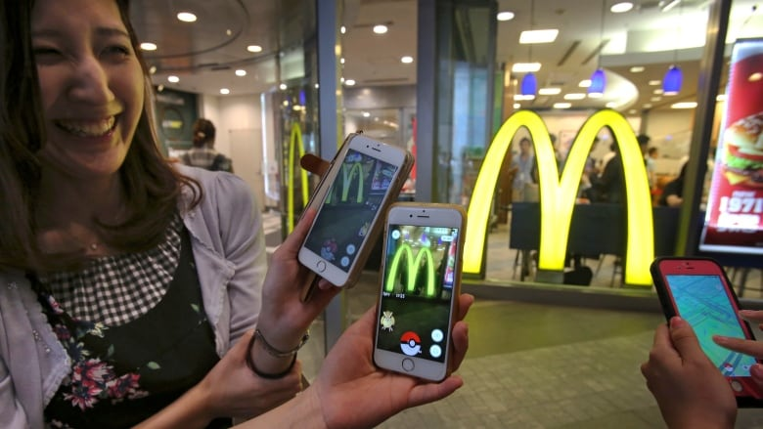
Pokemon Go launches in Japan
“The McDonald's deal will constitute a second revenue stream for Niantic that other games cannot possibly have for systemic reasons.”

Slide 47
