Slide 1
Digital Alienation

Slide 2
Traditional Alienation
Labour
Coercion
Estrangement
Alienation

Slide 3
Digital Alienation
Existence
Coercion
Estrangement
Digital Alienation

Slide 4
Digital Alienation
All digital human activity has economic value
Value is derived through commercial surveillance
Commercial surveillance is ubiquitous
Core economic unit is the personal profile:
Digital Persona (communicative activity)
+
Data Shadow (record of all digital activity + secondary analysis)
Alienating factors:
Existence
Use of digital systems replaces labour
Value is extracted via surveillance
Co-ercion (lack of choice)
No alternatives
Cannot be avoided
Estrangement
Lack of knowledge
Lack of power
Commodified Personalization

Slide 5
Process of digital alienation
Personal Profile
- alienated - coerced
- commodified - hidden
Digital Persona
SOLD
Conscious
Communicative Acts
Curtain of secrecy
Unconscious
Data Shadow
Incidental Activity
USED
IP rights
walled gardens
estrangement
Points of value extraction

Slide 6
Estrangement
Isolated from essential aspects of yourself
Can only express
What can be put into numbers
What they can sell
Hidden
What?
Who?
Uncontrolled


X

Slide 7
Coercion
Direct coercion
Threat communicated directly to you
Structural coercion
Lack of choice
Nudging
Small and apparently insignificant details can have major impacts on people’s behavior
Reshape the lines on the roads to slow drivers down
Place horrible pictures on cigarette packets
Don’t read privacy policy because it would take a week
Achievement badges in games
Not focused on conscious/rational choice

Slide 8
Exploitation
Your value per year:
Instagram: €320 (5c/hr)
Google Search: €200 (15c/hr)
Facebook: €170 (2c/hr)
Twitter: €90
LinkedIn: €80
Tik Tok: €60
Snapchat: €10 (0.5c/hr)
Personalisation and filter bubbles

Slide 9
Filter Bubbles
Filter Bubble = a state of intellectual isolation caused by personalised news feeds
users become separated from information that disagrees with their viewpoint
Isolates people in their own ideological bubbles
Hidden - Most do not realise it is happening
75% of Facebook users, 90% of Google users
Reduces exposure to conflicting views
Empirical dangers:
Confirmation bias
Psychological harm
Misinformation
Social sorting
Fake news
Undermines democracy
Generates untrue intellectual complexes
EG: Ant-Vax, Sovereign Citizens, Flat Earthers

Slide 10
Smart City
Our future

Slide 11
What is a Smart City?
BASIC: Integration of digital infrastructure into city
Sensing systems
Response systems
Automated activities
Maintenance
Services
Management
Social imaginaries
a broad understanding of the way a social group imagine their collective social life
Charles Taylor, “Modern Social Imaginaries”, Public Culture 14.1 (2002) 91-124 <https://muse.jhu.edu/article/26276>
City as a service(s)
City as a controller

Slide 12
What is it?
No single definition of “smart city”
Usage derives from purpose of account
3 types of account
What we can do with it
What it is made of
Develop a layered model
What is agreed
Ubiquitous sensor fabric
Lots of networking
Data processing
Personalised service delivery
Impact on ethical analysis
Based on specific technologies or usages
But – life in the smart city results from everything interacting

Slide 13
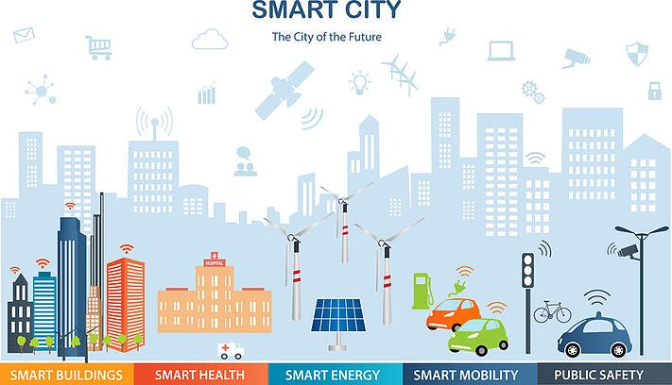
Visions of the Smart City

Slide 14
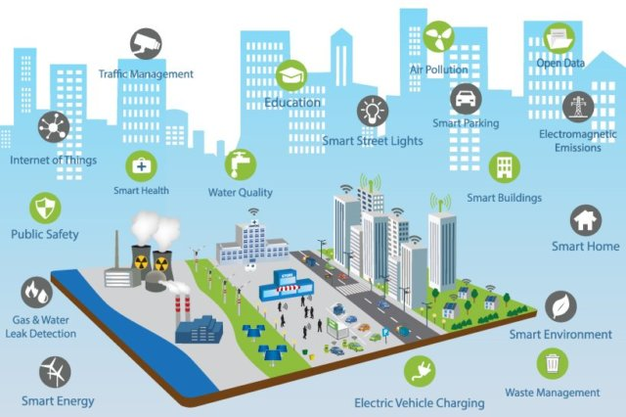
Visions of the Smart City

Slide 15
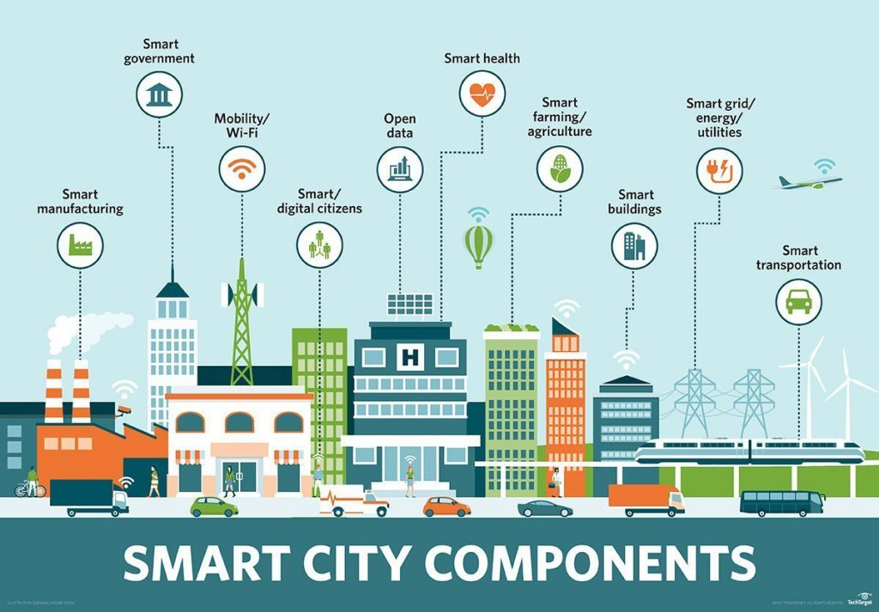
Visions of the Smart City

Slide 16
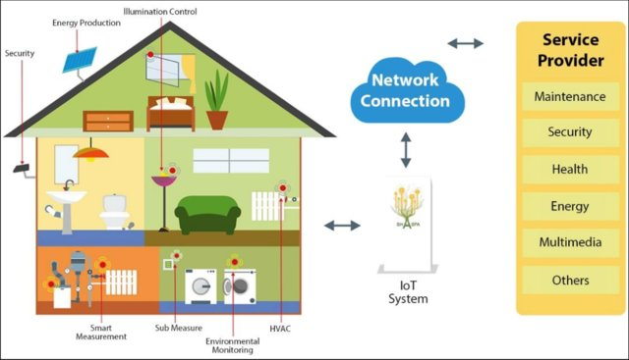
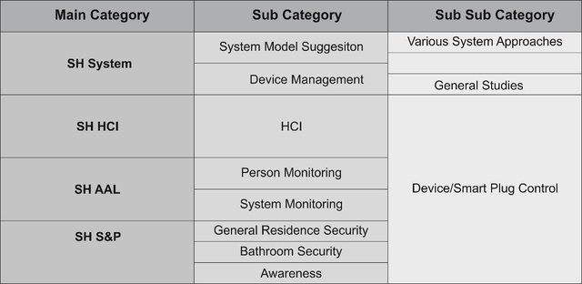
Smart Home

Slide 17
Wearables

Slide 18
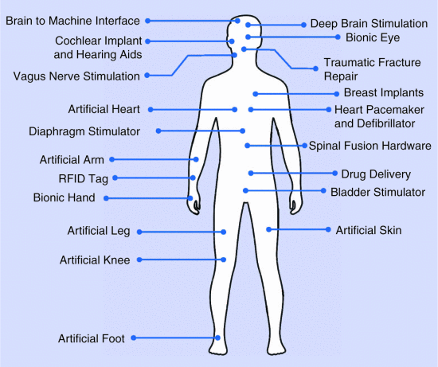
Implanted Tech

Slide 19
Models
Aristotle’s four causes (αἰτία (“to ask”) “cause”, “category”, “description”)
Final – Services/Goals
Environment: Sustainable
Social Services: Inclusive, efficient, cost-saving
Politics: Democratic/Authoritarian
Material - Layers – a computer system
eg: four-layer model
Sensors
Networks
Cloud-based data management
Service delivery
Efficient - Organisational – a social system
eg: public-private axis
Personal
Car
Home
Office
Civic Space
Formal – as a whole – a cyber-biological system

Slide 20
Smart Cities
Multiple technologies, systems, devices
Defining technologies
Robots
AI
Ambient intelligence
Interacting with each other
Combined effect on people
Digital environment
Ubiquitous sensor fabric
Lots of networking
Data processing
Personalised service delivery
Cannot separate people from technology
EG: search engine effect, Facebook posts

Slide 21
Systems Theory
Interdisciplinary study of systems
Systems are complex entities created by the interaction of the parts.
You have to understand the system, not its parts, to predict its behavior.
Parts of a system are called nodes
points of interaction, communication, or function within the network.
Understanding the role and connection of each node is essential to grasp the system's overall behavior.
Emergence = system’s properties “emerge” through interactions of the nodes
Complex behaviors emerge from the collective dynamics of simpler nodes
Reductionism tries to understand by breaking them down into their simpler components
overlooks the emergent properties that arise
Feedback Loops are important
Changes in one part of the system can have widespread effects

Slide 22
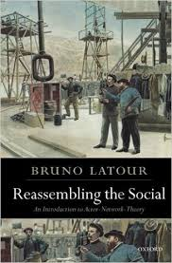
Actor Network Theory Bruno Latour
No ontologies
No organising of things into hierarchies or types
Smart city as a “system of systems”
System = network of “actants” (nodes)
Can be digital or human, single or multiple
People will have to adapt to the tech
Tech has needs
AI means tech will develop own responses
ANT allows for people & tech as equal causes of each other’s activity

Slide 23
Autopoiesis Niklas Luhmann. The Autopoiesis of Social Systems. 1986
Autopoietic systems are self-maintaining
EG: living organisms
Social systems are self-maintaining systems of communication
Communication is an event
information => understanding => utterance
Seen in smart cities
input => processing => output
BUT – can’t distinguish between digital and human causes, one or many
Often will be result of both

Slide 24
Integrated Domain
Smart city is a system
Elements of the system are nodes
ANT = material composition of node irrelevant
Concerned with patterns of connection, how flow is changed
Node can be human, digital device, device+human, etc..
Autopoiesis = system is self-organising and dynamically maintains structure via communicative events: hear → understand → express
Integrated domain
City is composed of digital/human nodes which bind system together via communicative events of input, processing, output
Exists when cannot attribute an event to either human OR digital, but only to combined activity of both

Slide 25
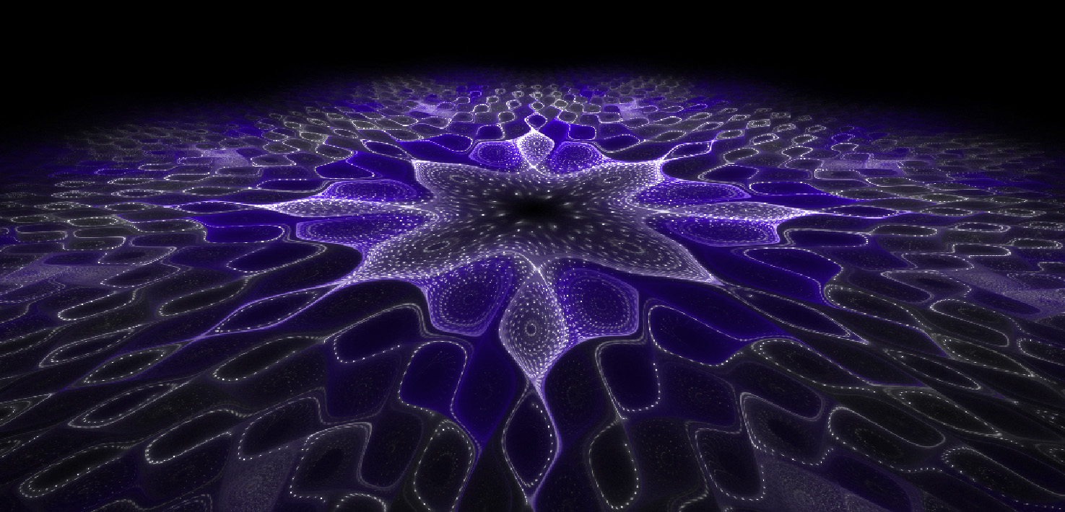
Integrated Domain
Smart city is an “integrated domain”
Impossible to identify activity as either human or digital, always a fusion of the two
Autopoiesis occurs at this level
Self-aware + self knowing

Slide 26
Digital Perspective
Digital Constructionism:
Digital systems are engineered, nothing natural
Digital Scepticism:
Digital systems do not perceive reality, only an engineered subset
Do not know us, only our representations in digital data
Digital systems are
Temporal
Only exist to degree they change/process data
Teleological
Designed to achieve a given/engineered purpose
Integrated domain is a system bound by a temporal flow of data and physical interactions
Understanding demands knowledge of actant’s goals

Slide 27
Integrated Node in Integrated Domain
data
processing
data
data
data
data
data
input
output
data
data
data
data
Integrated Node
TIME

Slide 28
Examples of Integrated Nodes
“Wherever understanding demands reference to both the human and the digital”
Me and my smart phone (+ fitbit + etc..)
integrated personage
IoT House + family inhabitants
Connected car (people, devices, mapping/navigation)
A video conference (people + devices + systems)
YouTube (people + systems + video content)
Google (people + devices + systems + standards + culture + money + organisational structures)

Slide 29
Integrated Nodes
Input → Processing → Output
Ethical concerns different for each stage
But shared across all technologies and contexts
Ontology is irrelevant
Integrated Personage
Human + personal devices
Primary unit of human interaction with the digital environment
Personal devices have special ethical status ∵ of their relation to the person
Can include concept of extended self
Floridi would include the data

Slide 30
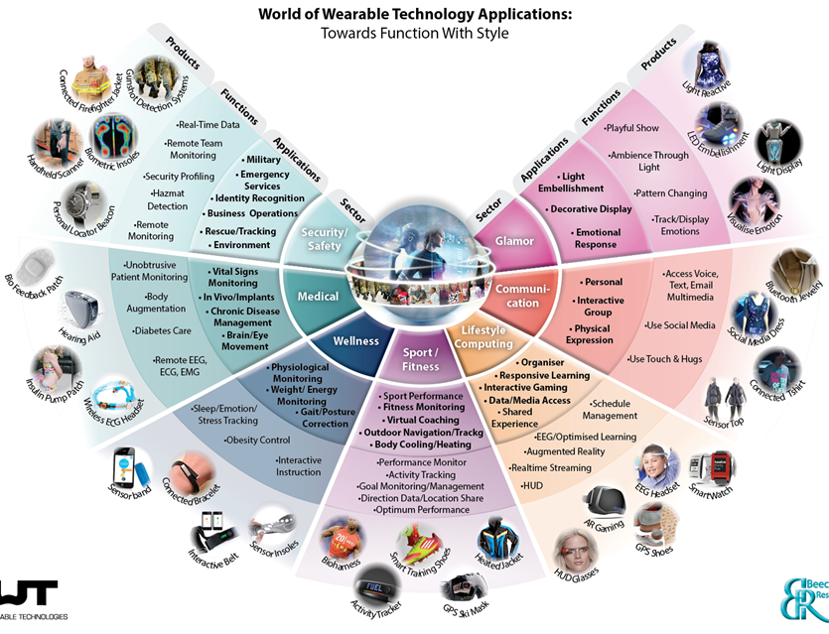
Integrated Personage

